Slide 1


Slide 2
Phaedrus Debt (PD) is a $1.6Bn private debt fund that has a base currency of USD. PD typically provides debt financing to 15 companies in USD, GBP, EUR and SEK, each loan lasting for approximately 5 years. The fund is considering issuing GBP debt to Games Workshop (link).
John, who is leading the transaction for the fund, has asked for your assistance evaluating the possible financial market risks involved in the transaction.
The important factor for debt fund managers to note is the range of potential outcomes to their base case IRR.

Slide 3
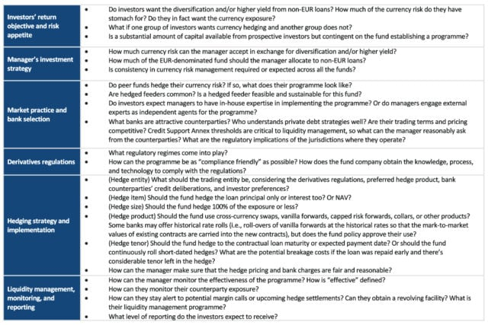

Slide 4
Please describe how you would go about identifying and quantifying foreign exchange (FX) market risk to the fund. Please include description of any metrics you might calculate to quantify this risk.
Appreciation or depreciation in the FX price impacting the IRR

Slide 5
After the level of risk has been quantified what instruments / securities would you recommend John using to mitigate the FX risk via a hedging program? Please provide expectations of cost profile, protection provided and any other important considerations for each instrument / strategy.
If the fund implemented your proposed strategies for hedging, what type of institution would you recommend they go to execute the trades? Can you explain any margin requirements and how the fund might meet them?

Slide 6
To identify and quantify the foreign exchange (FX) market risk involved in the transaction of issuing GBP debt to Games Workshop, we should follow a structured approach:
1. Identify the FX Exposure:
Transaction Exposure: Evaluate the direct impact of exchange rate fluctuations on the specific transaction of issuing GBP debt. This includes assessing how changes in GBP/USD exchange rates will affect the fund's returns.
Translation Exposure: Since the fund's base currency is USD, converting the GBP-denominated debt repayments into USD introduces risk. The value of future cash flows in GBP needs to be translated back into USD.
Economic Exposure: Consider the long-term impact of exchange rate changes on the fund's competitive position and overall profitability.
2. Data Collection:
Historical Exchange Rates: Gather historical exchange rate data for GBP/USD to understand past volatility and trends.
Market Forecasts: Review financial market forecasts for GBP/USD to gauge expected future movements.
Interest Rates: Obtain current and projected interest rates in both GBP and USD, as these can influence exchange rates and borrowing costs.
3. Quantify the FX Risk:
Value at Risk (VaR): Calculate the potential loss in value due to adverse exchange rate movements over a specific period with a given confidence level. This involves:
Estimating the distribution of exchange rate returns (e.g., using historical data).
Determining the potential maximum loss for the GBP-denominated debt.
Scenario Analysis: Perform scenario analysis to evaluate the impact of extreme but plausible changes in exchange rates. For instance, consider scenarios where GBP depreciates significantly against USD.
Sensitivity Analysis: Measure the sensitivity of the fund's cash flows and valuations to changes in exchange rates. For example, assess how a 1% change in GBP/USD would impact the fund's USD-denominated returns from the GBP loan.
4. Hedging Strategies:
Forward Contracts: Lock in the exchange rate for future GBP-denominated debt repayments by entering into forward contracts. This mitigates the risk of unfavorable exchange rate movements.
Options: Use currency options to provide a hedge against adverse movements while allowing for potential benefits if the exchange rate moves favorably.
Natural Hedging: Match GBP liabilities with GBP assets or revenues. If the fund has other investments or income in GBP, these can naturally offset the FX exposure.
5. Continuous Monitoring and Management:
Regular Reporting: Implement a system for regular monitoring and reporting of FX exposure and risk metrics.
Reassess Hedging Strategies: Periodically review and adjust hedging strategies based on market conditions and fund performance.
Stress Testing: Conduct periodic stress tests to evaluate the fund's resilience to extreme FX movements and to ensure that risk management strategies remain effective.
Conclusion:
By systematically identifying the FX exposure, collecting relevant data, quantifying the risk using tools like VaR, scenario, and sensitivity analysis, and implementing appropriate hedging strategies, the fund can effectively manage the FX market risks associated with issuing GBP debt to Games Workshop. Continuous monitoring and reassessment of the strategies will ensure that the fund remains protected against adverse exchange rate fluctuations.

Slide 7
John is also concerned about the market risk at the underlying corporate level. As such, please determine how much exposure does Games Workshop (i.e. the company) have to financial market risk (FX, Rates, Commodities, etc) and advise of any implications?

Slide 8
A condition of the loan is that the fund requires Games Workshop to hedge the interest rate risk associated with the new GBP debt. Can you explain some hedging alternatives for Games Workshop (i.e. specific hedging instruments)?

Slide 9
Given what you know about Validus' service offering, the content of this case, and your knowledge of Phaedrus Debt, please prepare an elevator pitch for Validus' services, to be delivered to John

